Slide 1
Class 22: Data aggregators Wednesday, March 6
INFO 3402: Information Expositions Professor Brian Keegan brian.keegan@colorado.edu

Slide 2
Agenda
11:00 – 11:05 → Review
11:05 – 11:30 → Lecture on data aggregators
11:30 – 11:50 → Brainstorming for Module Assignment 04

Slide 3
Recap
Weeks 1 & 2 → Module 1: Exploring
Characteristics of a good question, Exploratory data analysis checklist
Weeks 3 & 4 → Module 2: Retrieving
Using requests, BeautifulSoup, etc. to scrape data from websites and APIs
Weeks 5 & 6 → Module 3: Cleaning
Creating tidy data (pivoting, melting, stacking) and handling missing data (dropping, filling, interpolation)
Weeks 7 & 8 → Module 4: Combining
Evaluating types of joins, deanonymization attacks, data aggregators

Slide 4
This week
Week 8 (Mar 4 – Mar 8) → Combining (Tell)
Deanonymization attacks, data aggregators
Module Assignment 04 due Friday, March 15 at 11:59pm
Week 9 (Mar 11 – Mar 14) → Aggregating (Show)
Summarization, group-by aggregation, playing with SQL

Slide 5
Data aggregation as a business model
Google: “We know what you’re looking for now, so we can target you with relevant ads.”
Facebook: “You shared your preferences with us, so we can target you with relevant ads.”
Twitter, Snap, etc.: “We pay others to get data about you, so we can target you with relevant ads.”

Slide 6
Google AdWords
“Be seen by customers at the very moment that they’re searching on Google for the things you offer.”
“Target your ads to customers in certain [regions]— or within a set distance from your business or shop.”
Google total revenue, 2017: $109.7 billion
Google advertising revenue, 2017: $95.4 billion
70.9% of revenue came from advertising on Google sites (search, etc.)

Slide 7
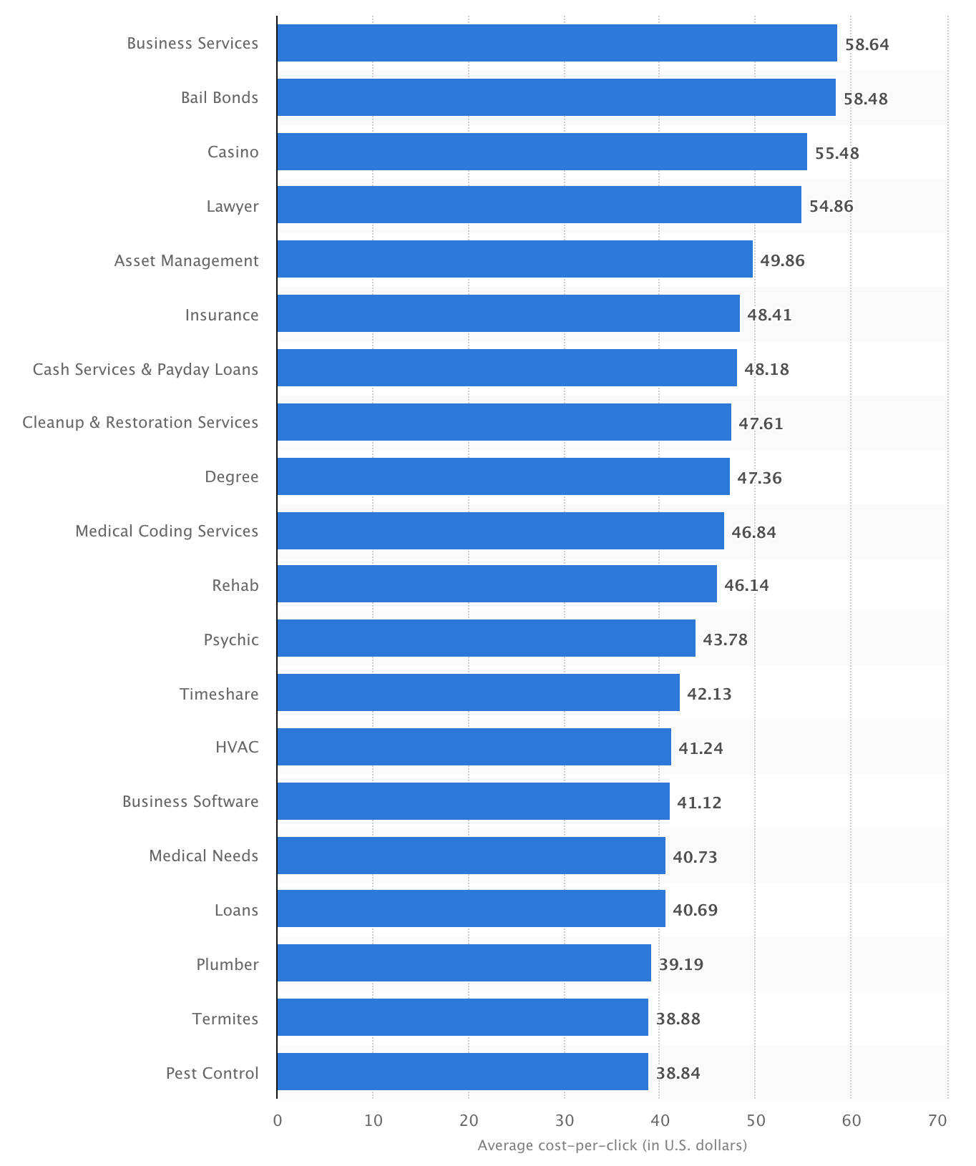
Most expensive keywords in Google AdWords
Source: https://www.statista.com/statistics/195680/share-of-keywords-prices-in-google-adwords-advertising/
Business Services: $58.64
Bail Bonds: $58.48
Casino: $55.48
Lawyer: $54.86
Asset Management: $49.86
Insurance: $48.41
Payday Loans: $48.18
Cleanup & Restoration: $47.61
Rehab: $46.14
HVAC: $41.24

Slide 8
Facebook Business
“Audience Network helps extend your campaigns beyond Facebook, delivering ads to more people you care about, in more places.”
“with over 2 billion people on our platform globally, Facebook is uniquely positioned to help you find the people most likely to be interested in your business, wherever they may be. …such as interests, demographics, age, education level, language.”
Facebook total revenue, 2017: $40.6 billion
Facebook advertising revenue, 2017: $39.9 billion

Slide 9
Twitter Business
“Use targeting features to choose the audience you want to reach. Select geographic areas, the followers of a notable account, or target people's interests.”
Twitter total revenue, $2.4 billion
Twitter ad revenue, $2.1 billion

Slide 10
Snap Ads
Snap revenue, 2017: $825 million
Snap advertising revenue, 2017: $804 million

Slide 11
Marketing side of social platforms
https://www.facebook.com/adsmanager/
https://ads.twitter.com/
https://ads.snapchat.com/
Data brokers
Experian
Datalogix/Oracle Data Cloud
Acxiom, Epsilon, CoreLogic, PeekYou, Exactis, etc.
Opt-out here: https://motherboard.vice.com/en_us/article/ne9b3z/how-to-get-off-data-broker-and-people-search-sites-pipl-spokeo

Slide 12
Module Assignment 4
Due Friday, March 15 at 11:59pm
Objective: Combine a diary study with a speculative analysis about how you could be re-identified
Diary study: What are traces of data you generated by or about you in all your behavior over a week? What would those data look like if you were in charge of designing them?
Searches, clicks, impressions, engagements, logins, mobility
Find examples of what these data look like now (documentation, etc.)
Speculative analysis: How could these different pieces of data be combined? What kinds of stories could they tell about your behavior ?
Fake up some data, perform the appropriate joins, and walk through an EDA that shows some behavioral patterns
Reflection: What—if anything—could you do to prevent this data from being generated or joined? What would you need to change about your behavior, about the data being collected, about the ways it’s analyzed, etc.?

Slide 13
Example
Objective: Combine a diary study with a speculative analysis about how you could be re-identified
“Do cannabis users spend more time watching documentaries?”
Diary study: What are traces of data you generated by or about you in all your behavior over a week? What would those data look like if you were in charge of designing them?
Loyalty program and/or cell phone locations & times + Netflix, Apple TV, Comcast, etc. consumption patterns
Speculative analysis: How could these different pieces of data be combined? What kinds of stories could they tell about your behavior?
Cell phone number from loyalty + cell phone records
Address from Netflix account + cell phone account
Reflection: What—if anything—could you do to prevent this data from being generated or joined? What would you need to change about your behavior, about the data being collected, about the ways it’s analyzed, etc.?
Privacy protections preventing common IDs like cell phone numbers from being joined to sensitive data

Slide 14
How would data look? Loyalty program
customer_id | address | phone
transaction_id | timestamp | customer_id | item_id
item_id | name | type

Slide 15
How would data look? TV consumption
customer_id | address | phone
customer_id | program_id | start_ts | stop_ts
program_id | name | genre

Slide 16
How would data look? Cell phone
customer_id | address | phone
phone_id | timestamp | latitude | longitude
business | industry | latitude | longitude

Slide 17
Join strategy
Join customer table and transaction table from loyalty program database on customer_id
(write out the join in SQL or pandas syntax)
Join consumption table and customer table from TV database on customer_id
(write out the join in SQL or pandas syntax)
Join the joined loyalty table and joined TV consumption tables together on address
(write out the join in SQL or pandas syntax)
Sparse data! Not everyone in the loyalty program is in TV consumption and vice versa
Prioritize keeping as much of the TV consumption data as possible → outer or left/right join, not inner

Slide 18
Analysis strategy
Compare TV consumption behaviors for users also present in loyalty program to those not in program
Significant sampling biases remain!!! Our loyalty program probably does not include all consumers
Use the cell phone data instead for people who spent time at retail stores? Still biased by plan?

Slide 19
Reflection
Is this question, combination of behaviors, analysis valuable to someone in the market?
Probably → Netflix, et al. could make different kinds of content for these specific and highly-engaged consumers
What kinds of privacy concerns would you have about companies and researchers combining these different data together? What rules already exist
If it could be done for this, it likely be done for other products/services as well that are far more sensitive

Slide 20
Brainstorming
What behavior would you explore? What would your research question be?
What kinds of data would you need? What would example data look like? Columns, values, etc.?
What would the join strategy look like? What would your analysis and results look like?
Use data mocking tools like Mockaroo (or make your own in pandas) to generate some fake data

